Slide 1
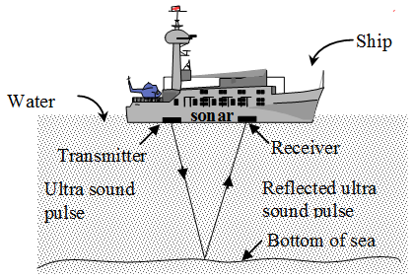
Binary Classification of Rocks and Mines Using SONAR Data
....Project By…. Sachin Sabale

Slide 2
Objectives The task is to discriminate between sonar signals bounced off a metal cylinder and those bounced off a roughly cylindrical rock. Or simply predict metal or rock objects from sonar return data.

Slide 3
What is “SONAR” system? (Sound navigation and ranging) To navigate, communicate with or detect objects on or under the surface of the water, such as other vessels.

Slide 4
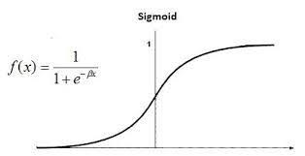
Classification in machine learning (Logistic regression )

Slide 5
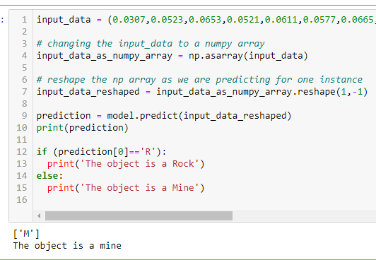
Final Output

Slide 6
Let’s code with Jupyter Notebook….

